Slide 1


College Admission Information
This presentation offers crucial insights into the college admission process, highlighting the various courses available, fee structures, eligibility criteria, and the admission procedure. It aims to assist prospective students in navigating their enrollment journey, providing essential contact details and the location of the institution.

Slide 2



Courses Offered
B.Tech Programs
MBA Specializations
B.Sc Degree Options
Bachelor of Technology in CSE, ECE, IT, and ME.
MBA with specializations in Finance, Marketing, and HR.
Bachelor of Science in Mathematics, Physics, and Chemistry.

Slide 3




Fee Structure Overview
2
MBA Fees
₹70,000 per semester
B.Tech Fees
1
₹50,000 per semester
B.Sc Fees
₹30,000 per semester
3

Slide 4


Eligibility for Admission
B.Tech Eligibility
MBA Eligibility
B.Sc Eligibility
Applicants must have completed their 10+2 education with Physics, Chemistry, and Mathematics (PCM) and should have a minimum of 50% marks.
Admission to the MBA program requires a graduation degree in any discipline with a minimum of 50% marks.
Candidates for the Bachelor of Science programs must have completed 10+2 with a science background and should have at least 45% marks.

Slide 5



Admission Process
1
2
3
4
5
Online Application
Document Upload
Entrance/Test Interview
Admission Offer
Fee Payment
Students must pay the required fees to confirm their admission.
Prospective students must apply online through the official college website.
Required documents need to be uploaded to verify eligibility and academic credentials.
Candidates must appear for an entrance test or interview to assess their suitability.
Successful candidates will receive an admission offer with next steps for enrollment.

Slide 6



Contact Details
Email Address
Questions can also be directed to admissions@mallareddyecw.com, where the admissions team will respond promptly.
2
Phone Number
For inquiries, prospective students can call +91-9123456789 to speak with the admissions office for assistance.
1
Website
3
For more information, students can visit the official website at www.mallareddyecw.com.

Slide 7
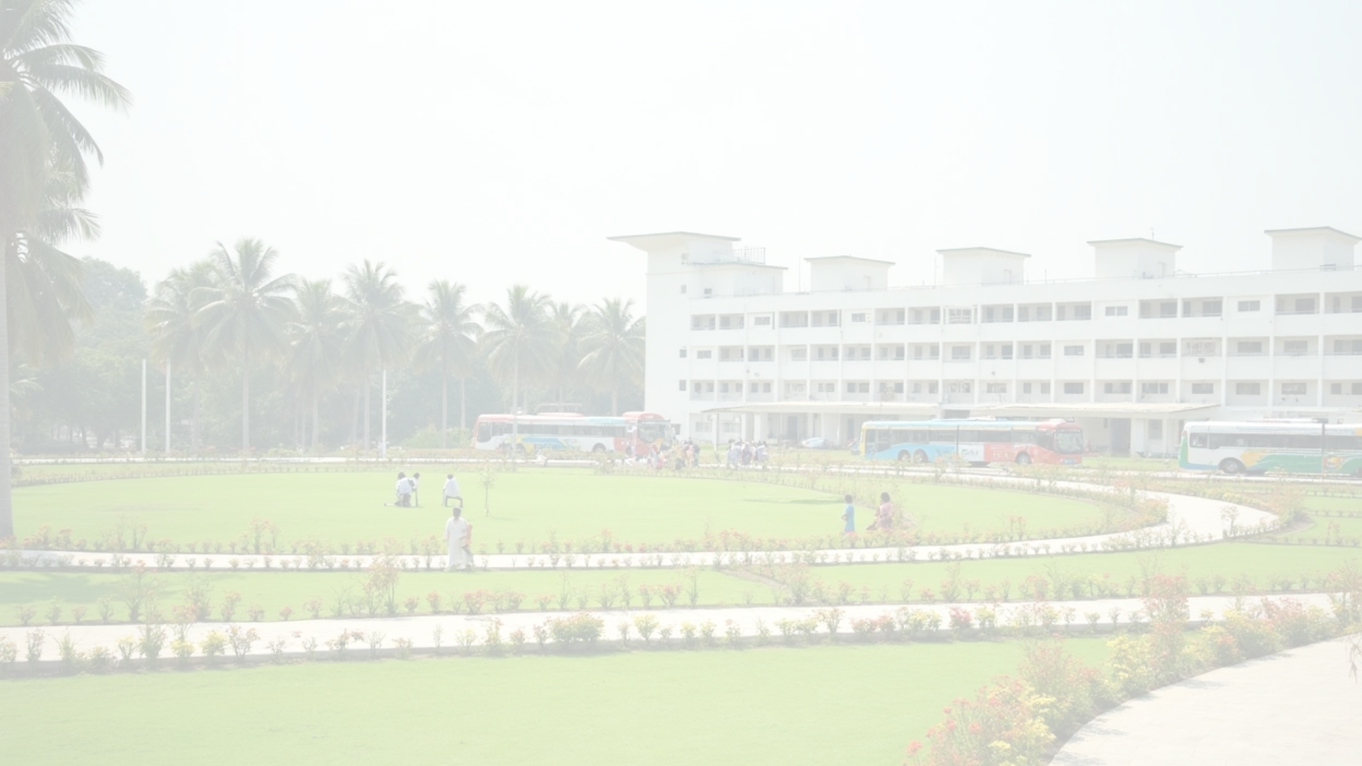
Location of Malla Reddy Engineering College for Women
Malla Reddy Engineering College for Women is situated in a tranquil environment at Maisammaguda, Dulapally, Hyderabad, Telangana – 500100. It is easily accessible by public transport, making it convenient for students from various parts of the city. The surrounding area offers essential amenities such as housing, dining, and recreational facilities.
College Address
Campus Accessibility
Surrounding Facilities
Located at Maisammaguda, Dulapally, Hyderabad, Telangana – 500100.
Easily accessible via public transport.
Amenities including housing, dining, and recreation available nearby.

Slide 8
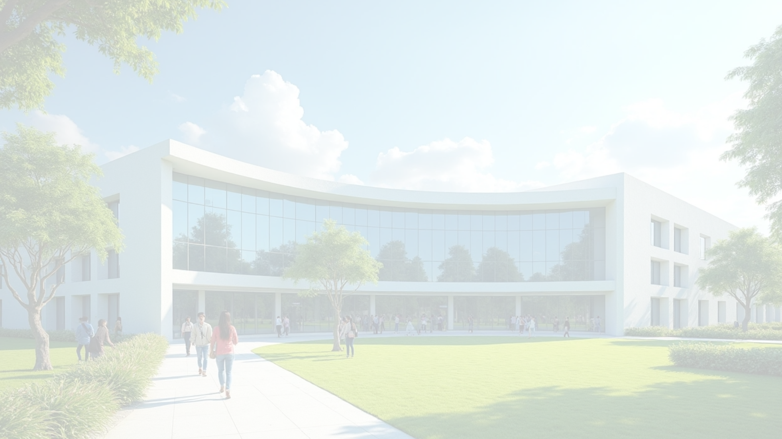
College Admissions Conclusion
This presentation has provided crucial information regarding college admissions, including courses, fees, eligibility, the admission process, and contact details. For any further queries, please reach out via the provided contact information. We look forward to welcoming you to Malla Reddy Engineering College for Women!
Crucial Information
Admission Process
Contact Us
Details on courses, fees, and eligibility.
Overview of the college admission steps.
Reach out with further queries.

